Slide 1
Forget Me Not Team Meeting #4
Cassady, Gardone, Suter

Slide 2
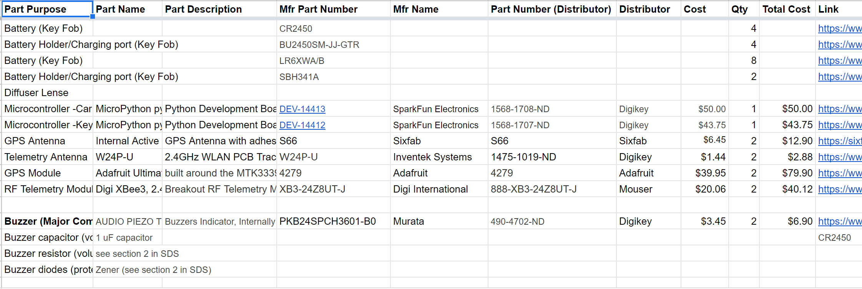
BOM updates

Slide 3
BOM updates
All Major Components selected
BOM due to sponsor by Friday
PCB and 3D rough design ideas need to be put together for this
Major Component selection could be changed by Friday depending upon PCB and 3D design

Slide 4
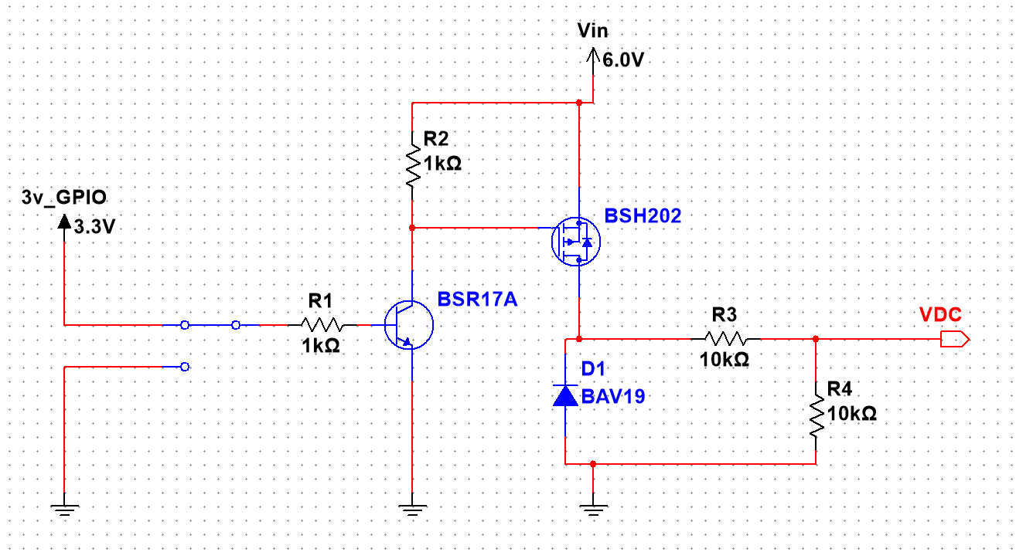
Power Estimation Circuit

Slide 5
SDS Questions
Can COTS “Principles of Operation” sections be copied directly from the datasheet?
Place holders in “Detailed Design” for not yet designed components.
Can the SDS update for requirement changes?
Difference between Detailed Design and Operational Concept sections?

